Slide 1






WEB APPLICATION TESTING
GREEN SUGAR
By Haidiner Roxana Maria

Slide 2



It is a Romanian online store with natural products

Slide 3






TESTING APPROACH
SMOKE TESTING
Verifying the essential functionalities to ensure that the software can perform its basic tasks without major errors or crashes.
EXPLORATORY TESTING
This application does not have requirements, so the testing it involves an investigation process that helps to find defects very quickly.

Slide 4




TOOLS USED
TEST LINK
SNIPPING TOOL
Test Case Management
Screenshot Captures
MANTIS BUG TRACKER
BROWSERSTACK
Bug Reporting Tool
Compatibility Testing
XMIND
SPEEDLAB
Mind Map
Performance Testing
W3C(validator)
YOPMAIL
HTML Error in Code
Mail Testing
CANVA
Presentation of the Project

Slide 5
TESTING TYPES
FUNCTIONAL TESTING
SMOKE TESTING
EXPLORATORY TESTING
API TESTING
NON-FUNCTIONAL TESTING
USABILITY TESTING
USER INTERFACE TESTING
SECURITY TESTING
COMPATIBILITY TESTING
CODE TESTING
PERFORMANCE TESTING
SYSTEM INTEGRATION TESTING

Slide 6
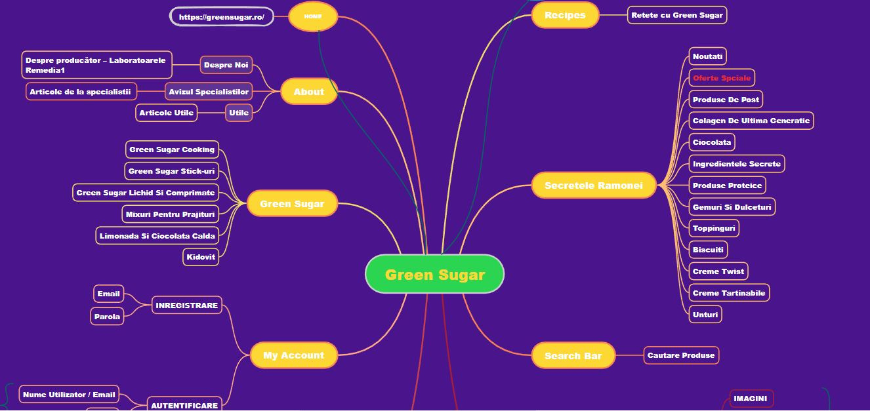


Slide 7








BUGS OVERVIEW
4 MINOR
10 NORMAL
3 MAJOR
1 BLOCKER
4 IMPROVEMENTS

Slide 8
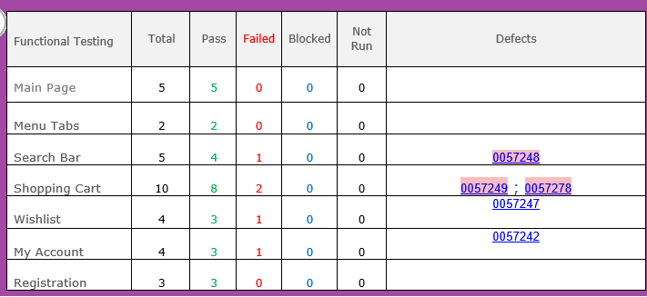

TEST CASES RESULTS
TOTAL 71
PASSED
FAILED
BLOCKER
53
17
1

Slide 9
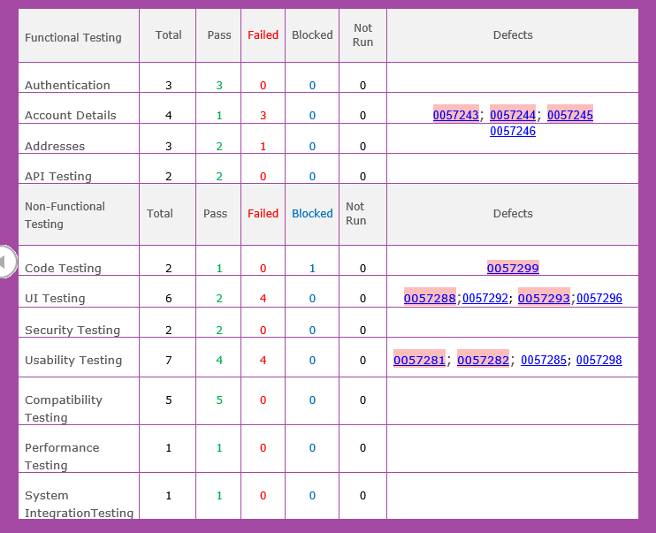
TEST CASES RESULTS
TOTAL 71
PASSED
FAILED
BLOCKER
53
17
1

Slide 10
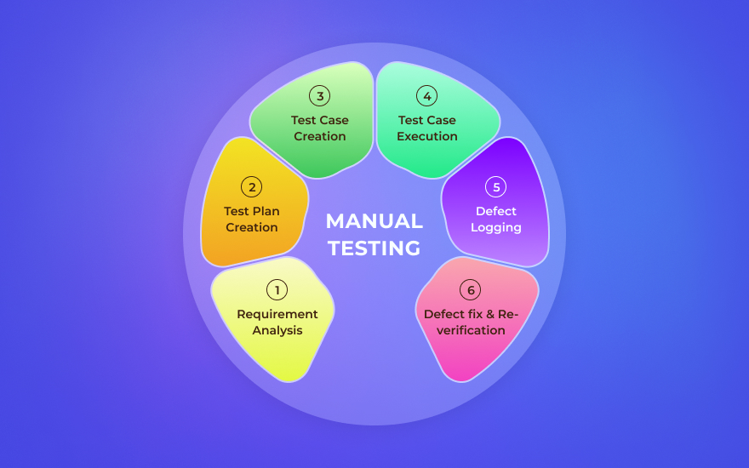
CONCLUSIONS
In this web application software testing, 71 tests were performed, of which 46 were Functional and 25 were Non-Functional
71
FUNCTIONAL
46
25
NON-FUNCTIONAL
•A total number of 18 bugs were identified. 50% of bugs were found in Functional Testing, and 50% discovered through Non-functional Testing.
4 very important improvements of the application are suggested
1 Blocker Bug
Notes:
In this web application software testing, 71 tests were performed, of which 46 were Functional and 25 were Non-Functional

Slide 11


LESSON LEARNT
SOFTWARE TESTING DEMANDS ANALYSIS SKILLS
SOFTWARE TESTING IS CHALLENGING
SOFTWARE TESTING REQUIRES COMMUNICATION SKILLS
SOFTWARE TESTING IS ABOUT CONSTANT LEARNING
SOFTWARE TESTING IS ABOUT UNDERSTANDING PRIORITY
SOFTWARE TESTING IS ABOUT ATTITUDE

Slide 12

THANK YOU!

